Slide 1
Mobile Testing Beyond Physical Reach
SOFTWARE QUALITY CONFERENCE
PACIFIC NW
JUAN DELGADO OCTOBER
PNSQC ™

Slide 2
AGENDA
SOFTWARE QUALITY CONFERENCE
PACIFIC NW
Juan Delgado Profile
Overview
Smartphone Test Farm
Demo
Question & Comments
PNSQC ™

Slide 3
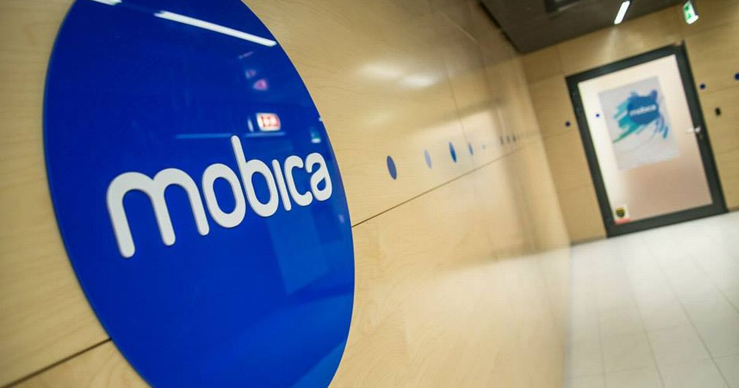
Juan Delgado - Profile
SOFTWARE QUALITY CONFERENCE
PACIFIC NW
PNSQC ™

Slide 4
Juan Delgado - Profile
SOFTWARE QUALITY CONFERENCE
PACIFIC NW
My name is Juan Delgado and I am from Mexico but living in Bellevue area in the last 2 years 6 months.
I have more than 10 years experience as engineer; I have been worked with all kind of IT Activities including development, support and in the past 7 years working on testing. I have a strong knowledge on the IT and business areas with a big inclination to learning and analysis of Business processes with experience in Functional testing and working on Agile or Waterfall Project with certification as Scrum Master and ITIL Foundations.
I have been participating in several different projects and in different locations (as working OnSite on US and Europe) in the last years. He has experience working On the Client Site in US and Europe; Near shore from Mexico to US, Offshore from Mexico and India to Europe; working strongly with Functional Testing focus on Automated Testing and Business Analysis
Currently I am working at Mobica an award-winning software development and integration services company with a global customer base.
Also, I'm Professor at Universidad Panamericana in the faculty of Engineering, focused on the subject of Software Quality Assurance, involved in the development and launch of interdisciplinary programs for students.
Member to the QA Minds community where we share experiences and help continuous learning about the best testing practices and techniques.
PNSQC ™

Slide 5
Overview Android Mobile QA Process
SOFTWARE QUALITY CONFERENCE
PACIFIC NW
PNSQC ™

Slide 6
Overview
SOFTWARE QUALITY CONFERENCE
PACIFIC NW
Android Mobile QA Process can be a convoluted and complex process. Mobile platforms, especially the ubiquitous Android, typically contain a multitude of devices and operating system versions.
While emulators help QA professionals somewhat deal with the differences in device types and OS versions, they really aren’t a replacement for the real thing. Testing on an actual piece of hardware remains the best way to truly benchmark a mobile app’s performance. Any mobile QA shop would benefit from setting up a device lab/farm to handle app and website testing on hardware.
PNSQC ™

Slide 7
Android Mobile Devices for Testing
SOFTWARE QUALITY CONFERENCE
PACIFIC NW
It is important to acquire a wide array of devices for your mobile QA lab. Obviously the underlying platform plays a big role in device procurement probably will need a host of Samsung, LG or HTC smartphones and tablets.
A good cross-section of screen dimensions, processors, and manufacturers (for Android) helps to ensure your team is able to test apps and websites in as many different hardware configurations as possible. Checking for overall performance on older devices is vital as well.
PNSQC ™

Slide 8
Smartphone Labs helps to Mobile QA Process
SOFTWARE QUALITY CONFERENCE
PACIFIC NW
Smartphone Lab/Farm helps the Mobile QA Process and the configurations on a lab’s devices is integral to the accuracy of your testing environment and success of your lab’s users. It’s important to replicate real-life user scenarios, and you certainly don’t want to start with a device that’s buggy or doesn’t have the right software for testing.
PNSQC ™

Slide 9
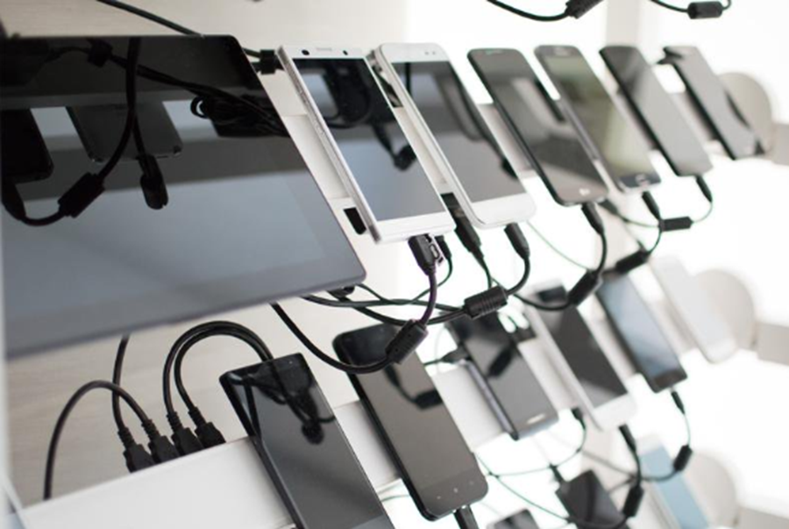
What is an Android Device Farm?
SOFTWARE QUALITY CONFERENCE
PACIFIC NW
An "Android Device Farm" is used in which different mobile devices connected in USB Hub and controlled remotely.
The device farm can be used to perform testing in your organization. Instead of taking the physical devices by the developers or testers, they can utilize this approach and start testing using the device remotely in their machines.
PNSQC ™

Slide 10
Smartphone Test Farm
SOFTWARE QUALITY CONFERENCE
PACIFIC NW
PNSQC ™

Slide 11
Smarphone Test Farm
SOFTWARE QUALITY CONFERENCE
PACIFIC NW
The Smartphone Test Farm (STF) was first developed by the software firm, CyberAgent, for use in their own mobile development projects. The tool was so successful they decided to make it available for everyone as an open source application on GitHub.
The STF is a open source tool that we can use to build a real device(Android) test farm. It is commonly called "Smartphone Test Farm" and thru a web application we can test smartphones remotely from the a browser.
We can set in our local host and it can be access from any computer so we can share our real device with our team or maybe others team in our office. We don’t need touch our real device to control it. We don’t need bring and return the real device to cabinets or rack. We just only sit and open our browser then access the test farm server.
PNSQC ™

Slide 12
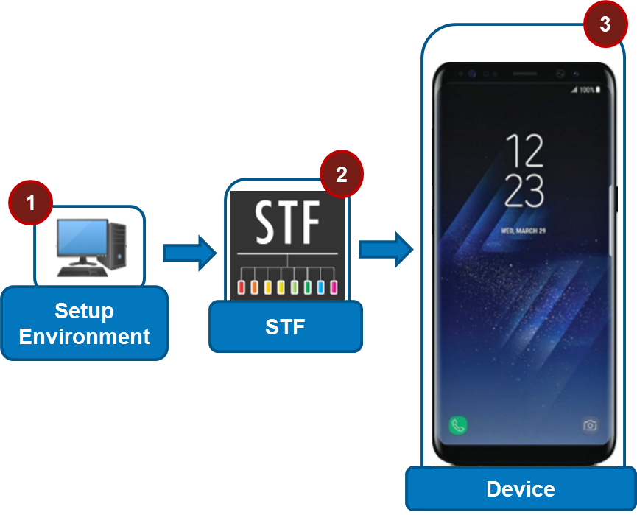
Smarphone Test Farm - Diagram
SOFTWARE QUALITY CONFERENCE
PACIFIC NW
PNSQC ™

Slide 13
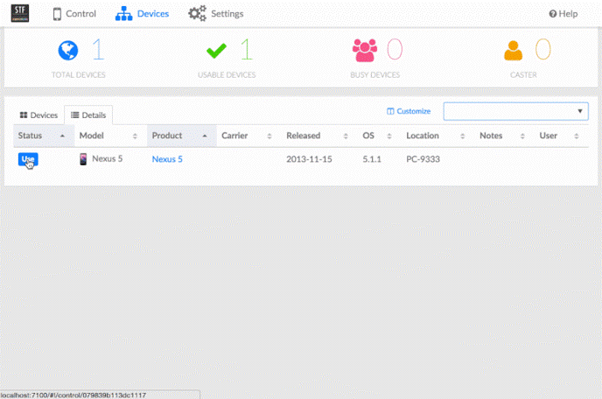
Smarphone Test Farm – Remote Access
SOFTWARE QUALITY CONFERENCE
PACIFIC NW
Connect to STF environment
Select a device
STF will display the device screen in browser
Interact with the Device
PNSQC ™
Notes:
Login
User
email

Slide 14
Smarphone Test Farm – Features
SOFTWARE QUALITY CONFERENCE
PACIFIC NW
Android devices
Keyboard & Mouse Input
Copy & Paste
Take Screenshots
Drag & Drop APK files
Open URLs
Display Logs
Run Shell Commands
Debug Remotely
Device Rotation, Play Store Automation etc.
PNSQC ™

Slide 15
Smarphone Test Farm – Usage
SOFTWARE QUALITY CONFERENCE
PACIFIC NW
Acquiring a Device
Releasing a Device
Working with a Device
Getting Activity Logs
Taking Screenshots
Remote Debugging with ADB
Getting device specific information
PNSQC ™
Notes:
Acquiring a Device
To acquire a device, simply click on one that's available on the "Devices" tab.
After acquiring a device, its screen should now be visible, it should respond to clicks and drags, as well as provide a plethora of ways to interact with the device.
Releasing a Device
After some time of inactivity (e.g. 15 minutes), the acquired device will automatically be released. However, after working with device, it should be released by the user. This operation will automatically return the device to the available pool of devices.
To release, simply click on the red 'x'.
Working with a Device
When a device is acquired by a user, it is possible to use interact with it using the local machine's mouse and keyboard. Mouse clicks simulate finger taps including swipes, long presses, etc.
Getting Activity Logs (e.g. Logcat)
To get logs from the device while in use, please specify the desired log level and click the 'Logs' tab on the bottom of the screen then select 'Get' to start the capture. It is possible to clear the captured logs by clicking the 'Clear' icon. When logging is no longer necessary, it can be stopped by clicking 'Stop'.
Please remember the logging will also stop automatically when device release is performed.
Taking Screenshots
Screenshots can be taken of an acquired device's screen. To do so, simply click 'Screenshot' on the 'Screenshots' tab. All screenshots will be deleted when the device is released, so remember to save them before releasing the device. Right-click on a screenshot and follow system save menu.
Debuggin with ADB
To debug a device with ADB (Android Debug Bridge), paste the 'Remote Debug' command into a terminal. Some installations will require the use of VPN in order to be able to access this function.
(Obviously, you need to have ADB installed!)
adb -s 172.20.0.102:7405 logcat > demo.txt
Getting device specific information
The 'Info' tab has additional device-specific details and includes mobile network and account information. Some device operating systems behave differently, so it's possible that not all information is available. For example, the account's phone number may not be available in the same way as another OEM's device. In that case, dialing #686# can quickly retrieve the phone number.

Slide 16
Smarphone Test Farm – Benefits
SOFTWARE QUALITY CONFERENCE
PACIFIC NW
Log and Debuging
Install .apk file, Just drag and drop in the browser!
Device Information; All information about the device such as API level, Phone Number, Screen size, etc.
Supports different version of Android.
The tool gives the user the opportunity to connect to several devices in parallel and then work on them by just selecting them from a browser.
PNSQC ™

Slide 17
Demo
SOFTWARE QUALITY CONFERENCE
PACIFIC NW
PNSQC ™

Slide 18
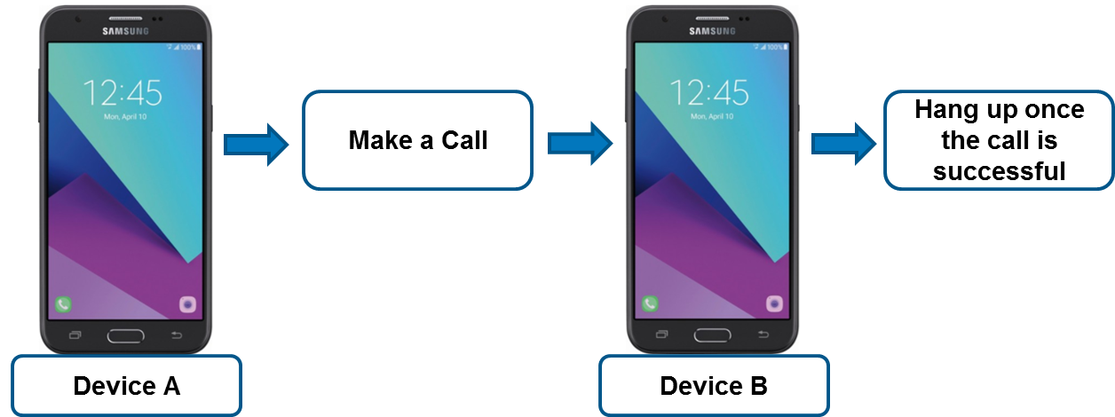
Situation E2E Workflow - Example
SOFTWARE QUALITY CONFERENCE
PACIFIC NW
PNSQC ™
Notes:
Access Tokens
Creating an Access Token
Removing an Access Token
Creating ADB Keys
Adding ADB Keys to the Device Matrix
API
Access Device Matrix API
Authorize
An Example method - Listing all devices by Serial Number

Slide 19
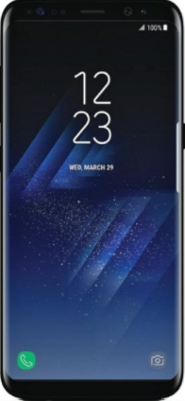
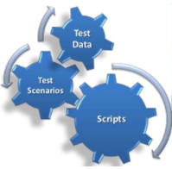
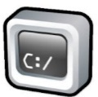
Proposed Solution with STF - Example
SOFTWARE QUALITY CONFERENCE
PACIFIC NW
5
Test Script
3
Business Solution
Test Script
4
1
2
Test Script
Test Script
Test Script
Setup Environment
User Input
Open STF
Test Script
Python/ UIautomator
Open STF
PNSQC ™

Slide 20
Questions & Comments
SOFTWARE QUALITY CONFERENCE
PACIFIC NW
PNSQC ™

Slide 21
Reference
SOFTWARE QUALITY CONFERENCE
PACIFIC NW
STF
https://openstf.io/
https://github.com/openstf/stf
Mobica
www.mobica.com
Juan Delgado
https://www.linkedin.com/in/juan-de-dios-delgado-bernal-0633aa14/
PNSQC ™

